Slide 1


Enable Your Organization With Tech Intensity
How to Author, Plan, & Host
Peter Laudati
Gino Filicetti
Cloud Architect - Microsoft
Cloud Architect - Microsoft

Slide 2
What The Hack What is it?
“What the Hack” is a challenge-based hackathon format
Challenges describe high-level tasks and goals to be accomplished
Challenges are not step-by-step labs.
By having to “figure it out”, attendee knowledge retention is greater
Attendees work in squads of 3 to 5 people to solve the challenges
Attendees “learn from” and “share with” each other.
Coaches provide technical guidance, but not answers to the squads
Coaches may provide lectures & demos to setup challenges & review solutions
What the Hack can be hosted in-person or virtually via Microsoft Teams

Slide 3
What The Hack Community Driven Principles
Anyone can contribute a new hack
All content is available for sharing broadly to enable cloud architects and partners to re-deliver to their customers
Designed to support virtual hack events via Microsoft Teams

Slide 4
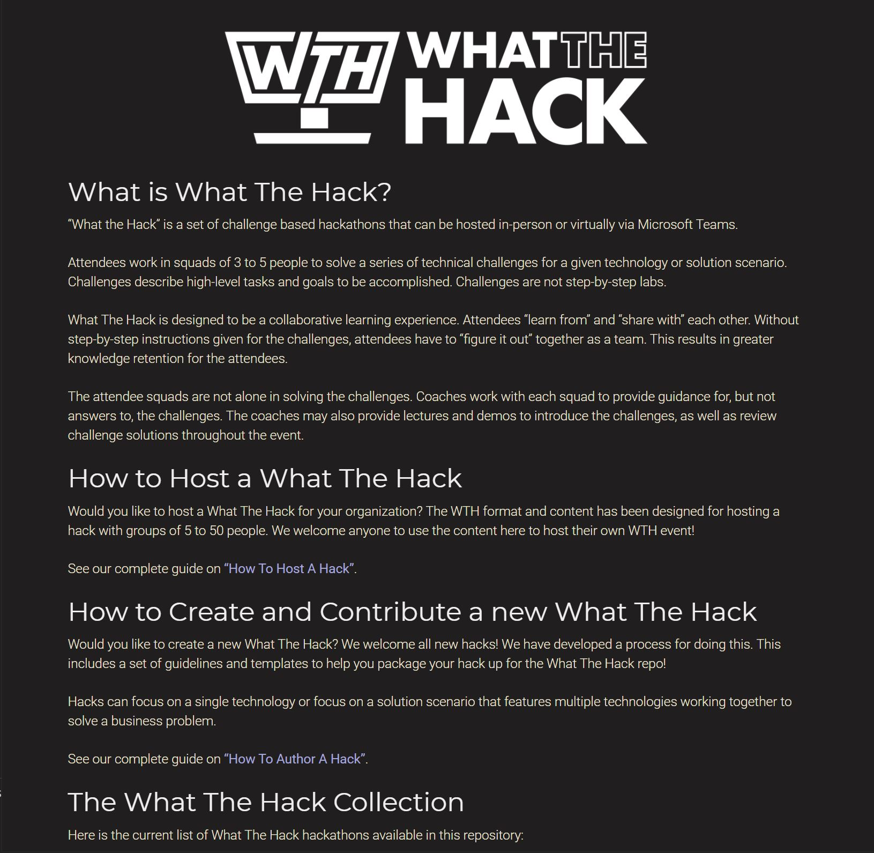
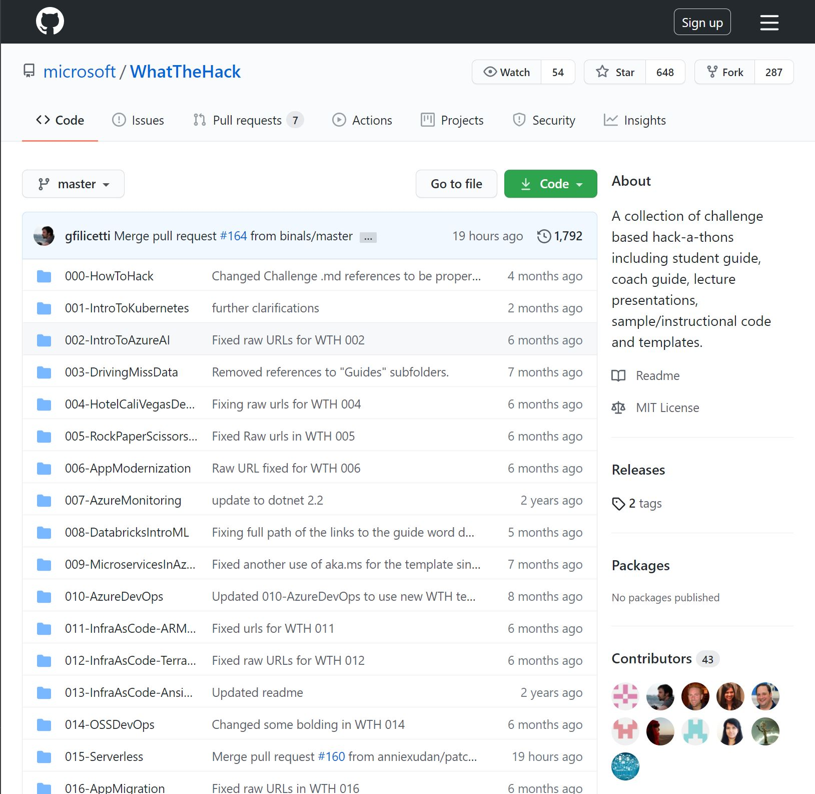
Separation of Concerns
https://aka.ms/wthhome
https://aka.ms/wthrepo
Notes:
We have TWO distinct front-ends for What The Hack content.
1.) WTH Home & Student Guides
You should always start off at our home page & student guides at: https://aka.ms/wthhome
This is where you’ll find all of the student facing content in a web interface that makes it easy to survey the content.
2.) WTH Repo on GitHub (Includes the solutions!)
The full content behind the scenes is on our Github repo, open for all to see. https://aka.ms/wthrepo
The repo contains the Coach’s guides and sample solutions for most of the challenges.
It should NOT be shared with the students ahead of or during the hack event!!!
Admittedly, this is security thru obfuscation. Smart students can and WILL find the repo during your event.
If they do, you should always remind them to not cheat themselves out of an educational experience!

Slide 5
What The Hack 2020 New Hacks – Thanks to the contributors!
Hack | Contributors
Infrastructure As Code: Terraform & Ansible | Pete Rodriguez
Azure DevOps | Shawn Weisfeld
Open Source DevOps | Ali Hussain, Kevin Hillinger, Kevin Gates, Israel Ekpo
BI 2 AI | Chris Mitchell, Chris Kahrs
Modern Data Warehouse | Jason Virtue, Alex Karasek, Annie Xu
Serverless | Nikki Conley
App Migration | Ryan Berry
Azure Governance | Farida Bharmal
Advanced Kubernetes | Tommy Falgout, Kevin M Gates, Michelle Yang

Slide 6
What The Hack New Hacks – Coming Soon in late 2020!
Mastering Linux Fundamentals
Identity For Apps
Migrating OSS Databases
Publishing to Azure Marketplace
Front Door CDN
Got a new What The Hack idea you would like to contribute?

Slide 7
How to Create & Author a new Hack
What The Hack!
https://aka.ms/WTHHowToAuthor

Slide 8
What The Hack How to Create & Author a new Hack
Fork the WTH repo into your Github account
Create a new top-level folder for your hack with the following structure:
045-MyNewHack
/Coach
/Solutions
/Student
/Resources
Follow the guidance and develop your content: https://aka.ms/WTHHowToAuthor
Submit a Pull Request back to the WTH repo with your new hack

Slide 9
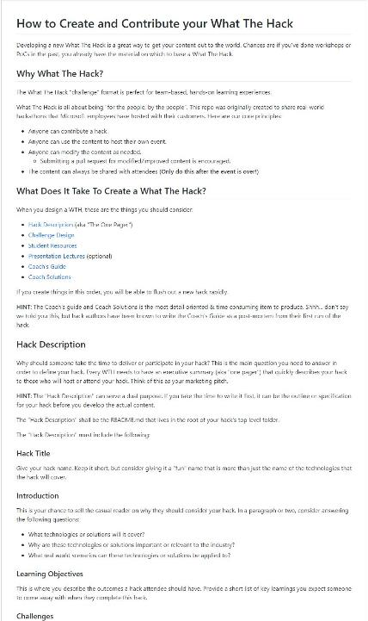
What The Hack How to Create & Author a new Hack
Hack Description
Challenge Design
Student Resources
Presentation Lectures
Coach’s Guide
Coach Solutions

Slide 10
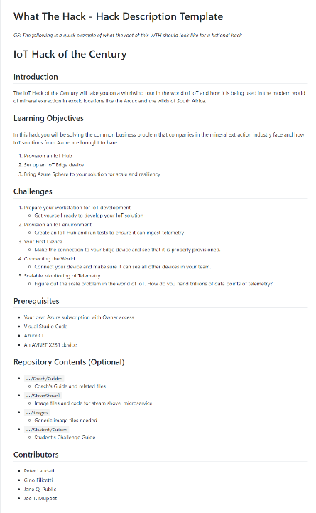
What The Hack Hack Description - Template
Introduction
Learning Objectives
Challenges
Prerequisites
Repository Contents
Contributors

Slide 11
What The Hack Challenge Design Guidelines
Challenges should be cumulative, building upon each other
Establish Confidence – start small and simple (think hello world)
Build Competence – by having successively more complex challenges
Each challenge should provide educational value.
For example, if an attendee completes only 3 out of 7 challenges, they still walk away feeling satisfied that they have learned something
Think through what skills/experience you want attendees to walk away with by completing each challenge
Challenge definitions should be short. A couple of sentences or bullet points stating the end goal(s) and perhaps a hint at the skill(s) needed
Include a “Challenge 0” that has pre-requisites for workstation environment

Slide 12
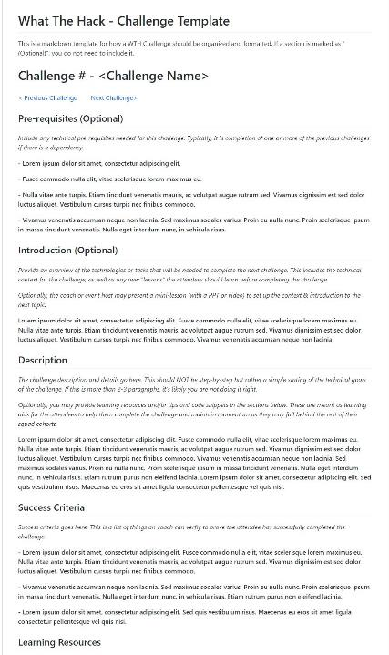
What The Hack Challenge Template
Prerequisites (Optional)
Introduction (Optional)
Description
Success Criteria
Learning Resources
Tips (Optional)
Advanced Challenge (Optional)
Navigation Links (Previous/Next)

Slide 13
What The Hack Presentation Lectures (Optional)
Brief overview of challenge scenario & technology
Brief overviews of concepts needed to complete challenges
Try to keep lectures <10 minutes per challenge
Slides with Challenge definitions that can be displayed when attendees are working on challenges

Slide 14
What The Hack Coach’s Guide
Coach’s guide should have:
List of high-level steps to the challenge answers/solutions
List of known blockers (things attendees will get hung up on) and recommended hints for solving them
List of key concepts that should be explained-to/understood by attendees before a given challenge
Estimated time for each challenge (NOT to be shared with attendees)
Suggested time a proctor should wait before helping out if a team is not progressing past known blockers
Coach’s guide may optionally have:
Pre-requisites for the Azure environment if needed.
Example: A VM image with Visual Studio or ML tools pre-installed.
Example: An ARM template and/or script that builds out an environment that saves time on solving a challenge
Slides that proctors can reference to help when teaching a key concept
Scripts/templates/etc for some challenges that can be shared with attendees if they get really stuck
Example: If challenges 1-3 build something (i.e. an ARM template) that is needed for challenge 4, you could “give” a stuck team the template so they could skip to challenge 4.
List of reference links/articles/documentation that can be shared when attendees get stuck
Coach’s guide should be updated during & post event with key learnings on what worked, didn’t work, and unexpected blockers that came up.

Slide 15
What The Hack Hack Folder Structure
/045-MyNewHack
Hack description (readme.md)
/Coach
Coach’s guide, lecture presentations, and any supporting files
/Solutions
Solution code for the coach only. These are the answers and should not be shared with the students.
/Student
The Challenge markdown files (or PDF/Word documents)
/Resources
The code and supporting files the students will need throughout the hack

Slide 16
How to Host Hack Event (In-person or Virtual)
What The Hack!
https://aka.ms/WTHHowToHost

Slide 17
What The Hack How to Host a Hack (In-person or Virtually)
Event Requirements
Event Preparation
Event Day

Slide 18
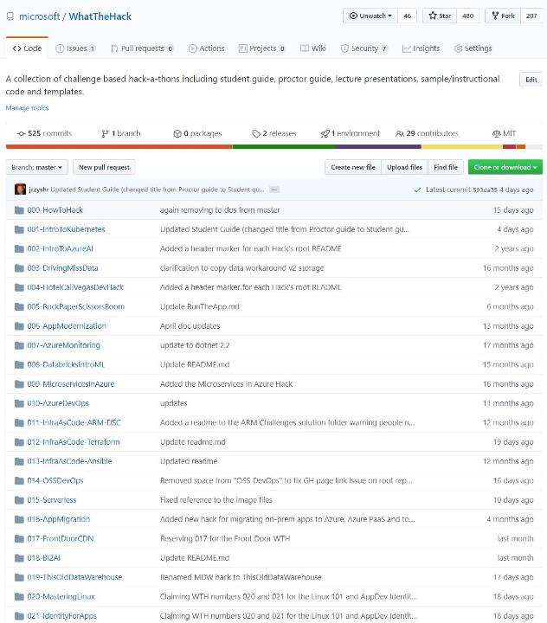
What The Hack Event Requirements
Hack Content https://aka.ms/wth
Notes:
Choose from the 20+ hacks in the WTH collection, or author your own!

Slide 19

What The Hack Event Requirements
Microsoft Teams
Notes:
Microsoft Teams is at the center of the WTH universe!
We use it for both in-person and virtual events, but Teams is what enables virtual events!
You will create a team in Teams for your event. More details on this shortly…

Slide 20

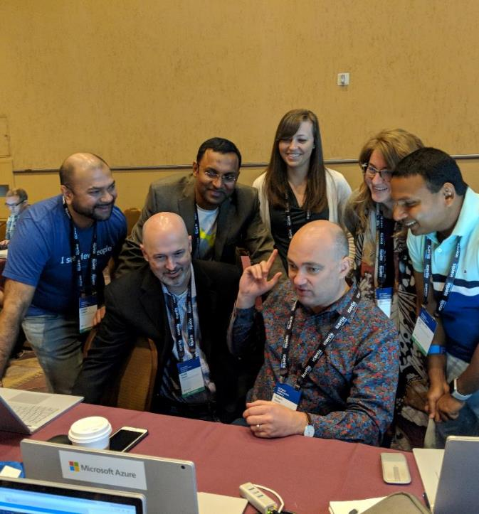
What The Hack Event Requirements
People
Lead Coach
Coaches – 1:5 recommended, 1:10 at minimum
Attendees – limited by # of available coaches
Notes:
Lead Coach
Lead of the event both logistically and technically
Responsible for event preparation
Should be intimately familiar with the content
Coaches
Facilitator/tech advisor for a squad of 3-5 students
Recommended 1:5 coach/attendee ratio, at minimum 1:10
Attendees
Students in the event that participate in squads of 3 to 5
For virtual events, students join a Teams channel meeting for the duration of the event with mic and/or camera on at all times

Slide 21
What The Hack Why deliver virtually?
Replicate and improve the experience for attendees.
Increase the level of interaction between attendees, coaches, and presenters.
Take advantage of all the benefits offered by a virtual environment.
There is a global pandemic going on!

Slide 22
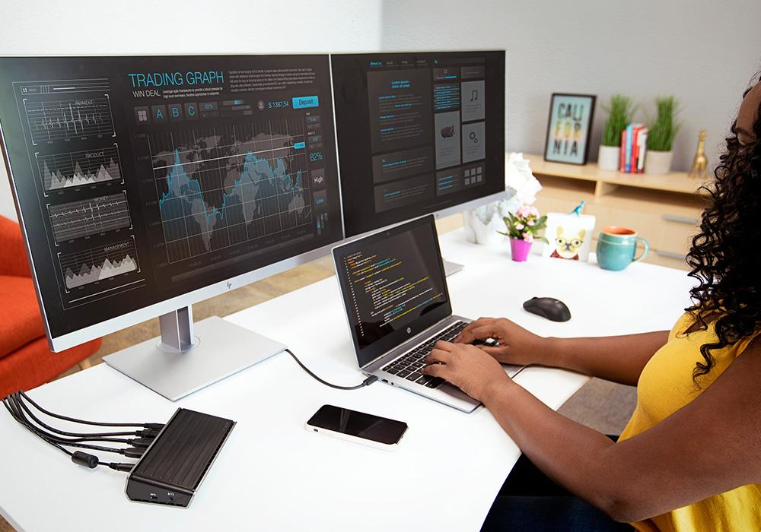
Notes:
I prefer virtual hacks because I get to be in the comfort of my own home office setup with multiple monitors, the ability to code, do research, and collaborate/chat all at the same time!

Slide 23

Notes:
Versus being hunched over a tiny laptop screen on a non-ergonomical chair crowded around 5 other people in an ice cold room in a conference center somewhere.

Slide 24
What The Hack How to Host a Hack – Event Preparation
Know Your Audience
Microsoft Team creation
Getting People To Your Event

Slide 25
What The Hack Event Preparation – Know Your Audience
Internal organization vs External organization
Internal == easy peezy ☺
External 1:1 or 1:many?
Microsoft Teams access
Azure Subscription
Attendee Workstation Security
Registration
Tip: Identify an event stakeholder in the external organization to own these concerns

Slide 26
What The Hack Microsoft Teams – External Event Considerations
Privacy – all attendees will be able to see each other
Guest access must be enabled on your AAD tenant
Licensing ** – 5 guests per licensed user in your company
Across your entire AAD tenant
Attendees are NOT required to be licensed
Tip: Host the event in the external organization’s Teams tenant and have them pull you in as the guest.
** Licensing information can vary, please consult your license agreement for more details.

Slide 27
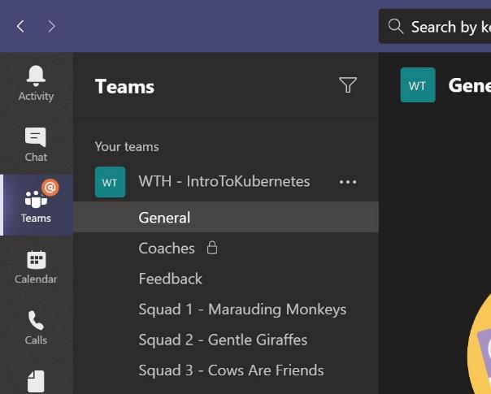
What The Hack Event Preparation – Microsoft Team Creation
General Channel
Central gathering place
Kick-off meeting
Event materials
Squad Channels
Virtual “tables” for squads to work at
Coaches Channel (Private)
Private channel to be used by coaches for event logistics
Feedback Channel
Used for attendees to post any comments on how to improve the event

Slide 28
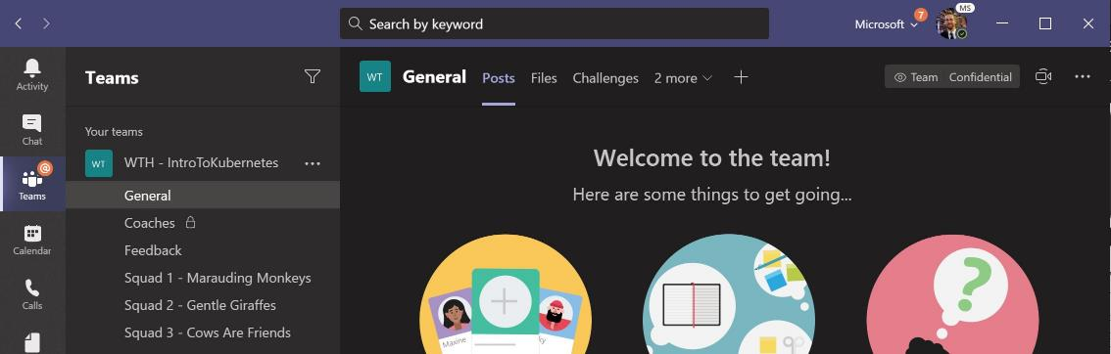
What The Hack Event Preparation – Microsoft Team Creation
Central gathering place. Kick-off & stand-up meetings take place HERE!

Slide 29
What The Hack Event Preparation – Microsoft Team Creation
Private channel to be used by coaches for event logistics

Slide 30
What The Hack Event Preparation – Microsoft Team Creation
DURING & after the event, share feedback with the coaches in the Feedback channel. This will help them improve the event as it progresses and make the next one even better

Slide 31
What The Hack Event Preparation – Microsoft Team Creation
Squad members hang out, communicate, talk, and screenshare in their squad’s channel.

Slide 32
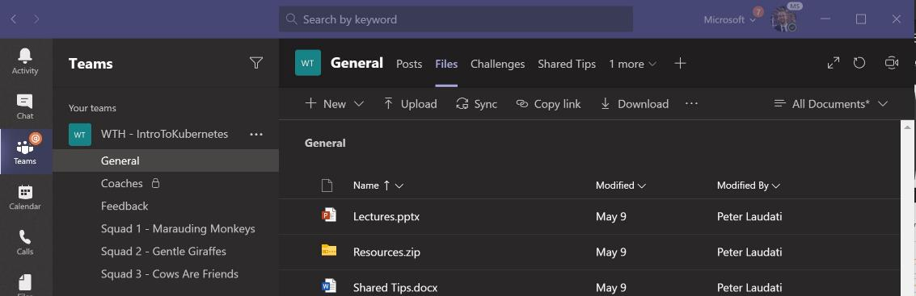
What The Hack Event Preparation – Microsoft Team Creation
Upload any files, resources, or code samples needed by the students here!

Slide 33
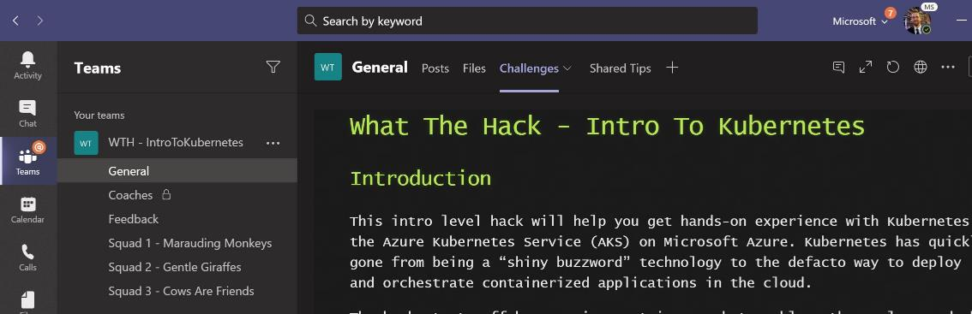
What The Hack Event Preparation – Microsoft Team Creation
Pin a link to the Challenges (website or PDF/Word document) here

Slide 34
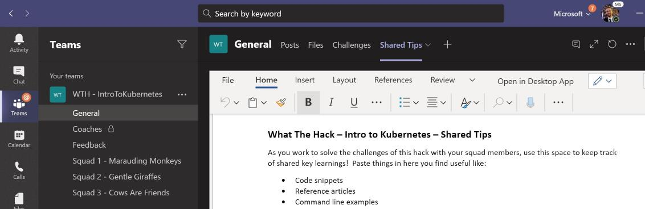
What The Hack Event Preparation – Microsoft Team Creation
Attendees share tips, tricks, gotchas (how they solved them), code snippets, and links they learn along the way here with everyone

Slide 35
What The Hack Event Preparation – Getting People To Your Event
Set up online registration
Add attendees to the team
Create a calendar invite
Automate with Microsoft Forms & Power Automate

Slide 36
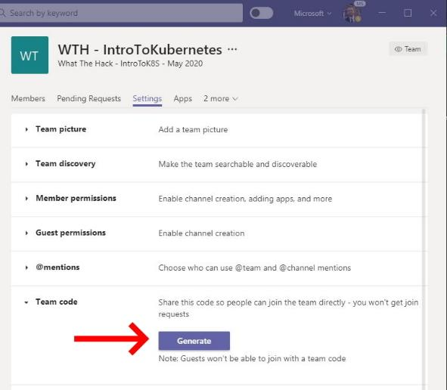
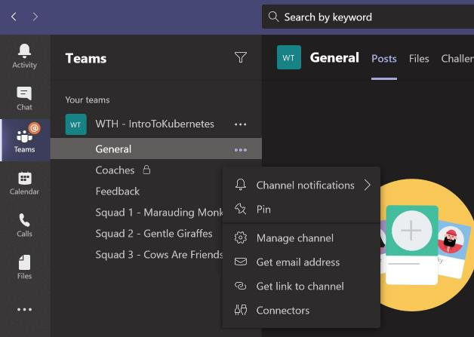
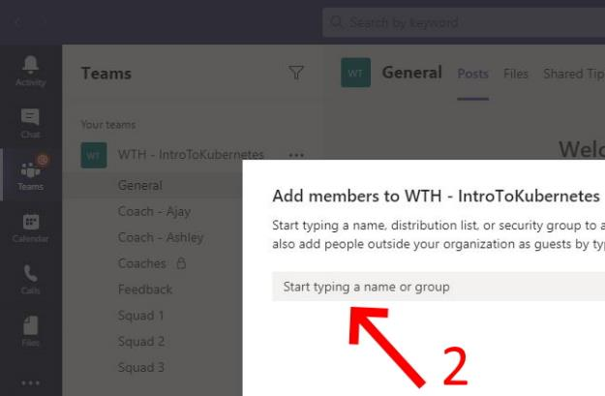
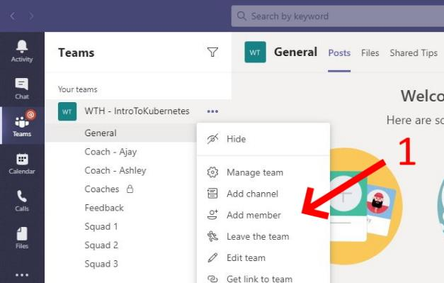
What The Hack Add attendees to the event team
Internal – Generate a Join Code
External
Must add each attendee manually through Teams Admin UI
Must be added before the event in order to access the kick-off meeting!
Get a link to the General channel

Slide 37
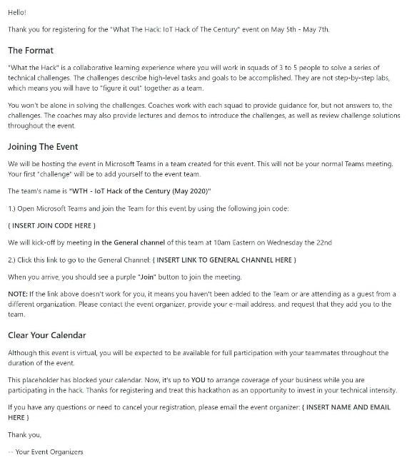
What The Hack Create Outlook Calendar invite
Provide link to Join Code
Provide link to the General Channel with instructions to join the kick-off meeting
Provide instructions to make arrangements for others to cover their business.
Provide instructions to put on their OOF messages.
Tip: Use the WTH calendar invite template: https://aka.ms/WTHCalendarInviteTemplate

Slide 38
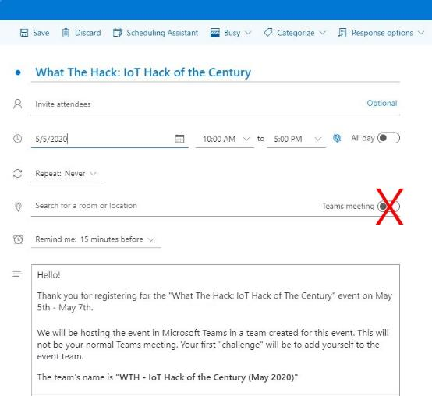
What The Hack Create Outlook Calendar invite
Note: When you create a calendar invite, you should NOT enable it as a Teams meeting in Outlook.
If you do this, Outlook and Teams will put a "Join Teams Meeting" or "Join" button in their respective calendar interfaces.
If attendees click that button, they will end up in a private meeting instead of the Channel meeting in the General channel.

Slide 39
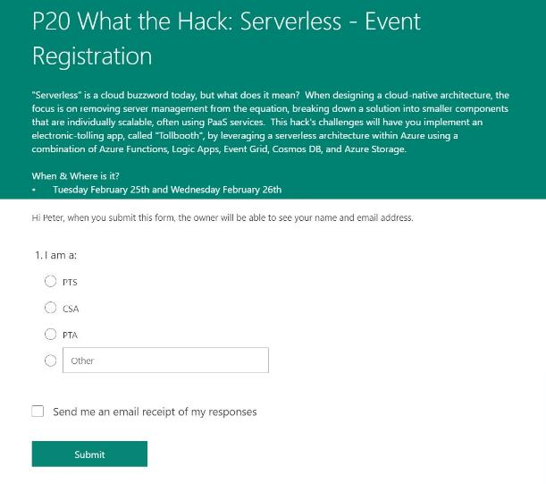
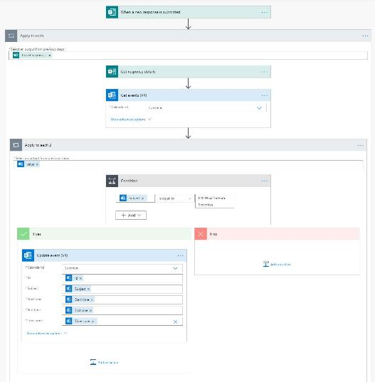
What The Hack Automate Internal Registration with Forms & Flow
Create Outlook calendar invite
Create Registration form in MS Forms
Use Power Automate to add registered attendees to the calendar invite

Slide 40
What The Hack How to Host a Hack – Event Day
Kick-Off Meeting
Hacking
Stand Ups
Virtual Event Tips

Slide 41
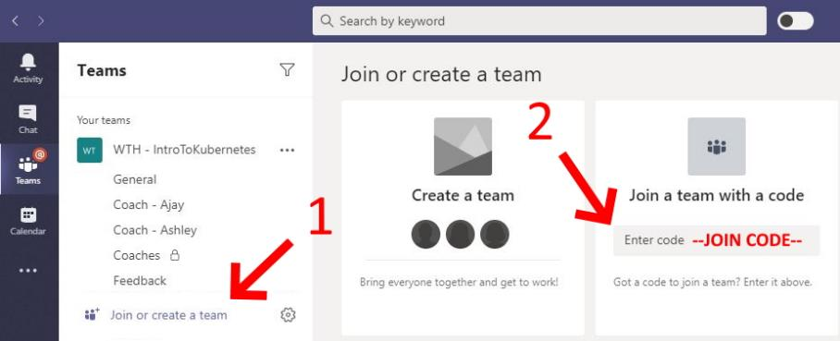
What The Hack Kick-Off Meeting – Getting There In-Person
Display the Join Code for the event team on a projector or a whiteboard in the room.
Have the attendees join the team

Slide 42
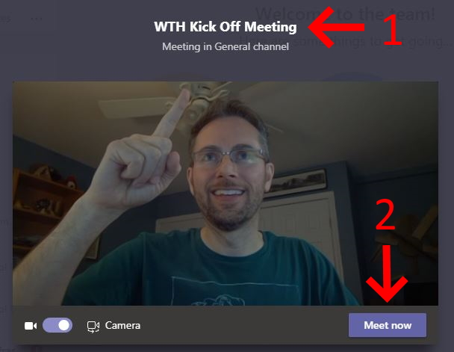
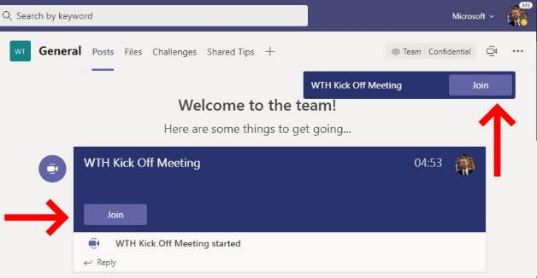
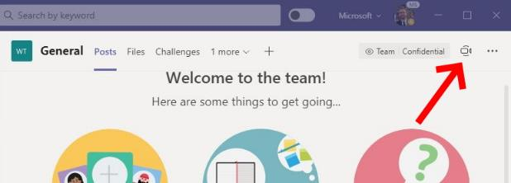
What The Hack Kick-Off Meeting – Getting There Virtually
Lead coach starts Kick-Off Meeting in the General Channel
Tip: Be sure to name the meeting before you start it!
Attendees click the General Channel link and then the “Join” button in the channel

Slide 43
What The Hack Kick-Off Meeting – Logistics & Squad Formation
Welcomes, Intros, & Logistics
Squad Formation
By Table - In-person event only
Load balanced by skill level - Encourage a mix of experts and novices so that there is shared learning. Experts are encouraged to help novices.
Segregated by skill level - Enables advanced participants to progress at a faster pace or take on additional challenges, while allowing novices to move at a less stressful pace as they work together to learn.
Play Dodgeball - Lead coach nominates a leader for each squad. Squad leaders then pick their squad members like in gym class at school.
Timezone – Virtual event only - Form squads by timezone. This enables squads to take break times that align to their timezone.
Random
Notes:
Once all attendees have arrived, congratulate them on completing their first challenge: Finding the Kick Off meeting!
Do welcomes & intros.
Cover logistics
if in person, restrooms, food, etc
Cover event format
work on challenges in squads of 3-5
Squads progress at their own pace
Coaches are technical advisors, but won’t give answers, etc
If virtual, give them a tour of the event team in Microsoft Teams and explain how they will use it (switching calls between general and squad channels)
Squad formation

Slide 44
What The Hack Event Day – Hacking
Lead Coach leads
Coaches coach
Attendees hack

Slide 45
What The Hack Hacking – Lead Coach
Anchors the room and handle announcements, etc.
i.e. The person with the skinny microphone!
Huddles the coaches if they need to share info during the event.
Presents any content to prep the attendees (event intro, logistics, mini-tech lectures, demos, etc)
Maintains list of unexpected blockers (and their solutions) that come up during the event. These blockers should:
Be recorded live to the coach’s guide and used for future events
Communicated to the attendees in the room.
Responsible for squad formation
Constantly solicits feedback throughout the event!

Slide 46
What The Hack Hacking – Coaches
Keep the squads working as teams!
Encourage all to “learn from” and “share with” each other!
If you observe individuals racing ahead, encourage them to help those who are behind.
Encourage attendees to use their squad’s channel on MS Teams to collaborate/share info!
Unblock teams who get stuck
Encourage squad members to unblock each other first!
Provide hints, but not answers
If you observe individuals stuck for a while, help them get moving so they don’t lose interest.
Provide hints/pointers to the squads on how to solve problems & where to find information.
Use the answers/solutions in the coach’s guide, but don’t share with the attendees
Coach’s guide won’t be comprehensive. As SMEs, coaches should use their knowledge to help with solution hints/ideas.
Notify the Lead Coach of unexpected blockers that arise during the event so they can be communicated to all and recorded for future reference.

Slide 47
What The Hack Hacking – Attendees
Learn
Do
Learn
Share
NOTE: Attendees should not be judged on how far they get. No trophies should be given for challenge completion. If event hosts want to gamify/incentivize attendees, they should focus on encouraging attendees to share with each other!

Slide 48
What The Hack Stand Ups
Stand ups after each challenge completed
Stand ups at beginning & end of each day
Stand up to wrap up event

Slide 49
What The Hack Virtual Event Tips
Keep mics & cameras on
Encourage break time & watercooler talk
Require attendees to keep an open mic and use cameras as often as possible. Noisy pets, kids, or spouses. It's all fine in the spirit of keeping remote attendees engaged and feeling as though they are together. Just remember to mute the toilet flushes!
If a coach observes an individual on mute for long periods of time or not speaking up as the squad hacks, the coach should reach out in a private chat to ask the person if they need help. The goal is to keep the person engaged in the hack and away from their email, phone, social media, etc.
If bandwidth is tight for an attendee, they can turn off their camera as well as the incoming video stream from other participants.
Coaches should never turn their cameras off so that attendees know they are available, especially during any lectures or re-caps
Stand-ups really need to be stand ups. Encourage attendees to take a break from their screen and headsets and walk around. Sitting at a desk for long periods is not healthy.

Slide 50
What The Hack Virtual Event Tips – Time Zone Recommendations
Attendees should be in a similar timezone region (+/- 3 hours) to optimize scheduling and collaboration.
Coaches should also be in the same timezone region. However, coaches can adjust their schedule to support remote attendees in a different region if needed. For example, a North American coach can agree to wake up early (4am) to support a virtual event scheduled for the European region.
Balance kick-off and end times across a time zone region with an early start for the western-most time zone and a later end time for the eastern-most time zone. For example, if hosting an event for North American attendees, start at 7am Pacific/10am Eastern. End at 6pm Eastern/3pm Pacific.
When forming squads, encourage folks to group by time zone. This allows the members of each squad to take the same lunch or dinner break together.
For a multi-day hack, after a shared kick-off meeting on day 1, coaches can designate the hours they will be available on the subsequent days. The squads can then decide to start earlier/finish later if all members are in the same time zone.
For example, coaches can be available 10am-6pm Eastern.
A squad in the eastern time zone can start 9am and finish at 4pm.
The squad in the western time zone can work the same hours in their own time zone, resulting in them working the last hour without a coach.

Slide 51
What The Hack Hybrid Virtual/In-Person Event Recommendations
Hosting an in-person event with remote attendees.
Group remote attendees into one or more squads consisting only of remote attendees. Don't mix and match.
Dedicate an in-person coach to support the remote squads
The dedicated in-person coach is responsible for making sure the A/V connections between the venue and the event team in Microsoft Teams is working
The dedicated in-person coach must represent the remote attendees to the lead coach & other in-person attendees. When questions come up online, the dedicated in-person coach can be the one to get the attention of the lead or other in-person coaches.
Hosting an event where the attendees are in-person, but the coaches are remote
This is a great solution when you want to host an event for attendees in a different region
The coaches need to adjust their working hours to support the remote region. For example, to support an event in Australia, a coach in the eastern US time zone would need to agree to work from 5pm to 1am.
This does require volunteers to be designated as facilitators in the physical venue. The facilitators are responsible for the A/V connectivity to the remote coaches and raising questions from attendees in the venue to the online coaches.
Hosting an event where individual squads work together in person, but distributed and remote from other squads.
For example, squads can work together in New York, Chicago, and Seattle. The lead coach may be in Chicago leading all three groups online.

Slide 52
What The Hack GitHub Repo
All hack content should be shared with attendees at the end of a What The Hack event:
https://github.com/Microsoft/WhatTheHack
The repo should NOT be shared with attendees before or during the event (because it will have the answers!)
Attendees should be encouraged to re-use the content to train others in their organization
Attendees should be invited to contribute their own hack ideas or submit pull requests with improvements to the current hack

Slide 53
Thank You! Good luck hosting your What The Hack event!
What The Hack!
https://aka.ms/WTHHowToHost

